Slide 1
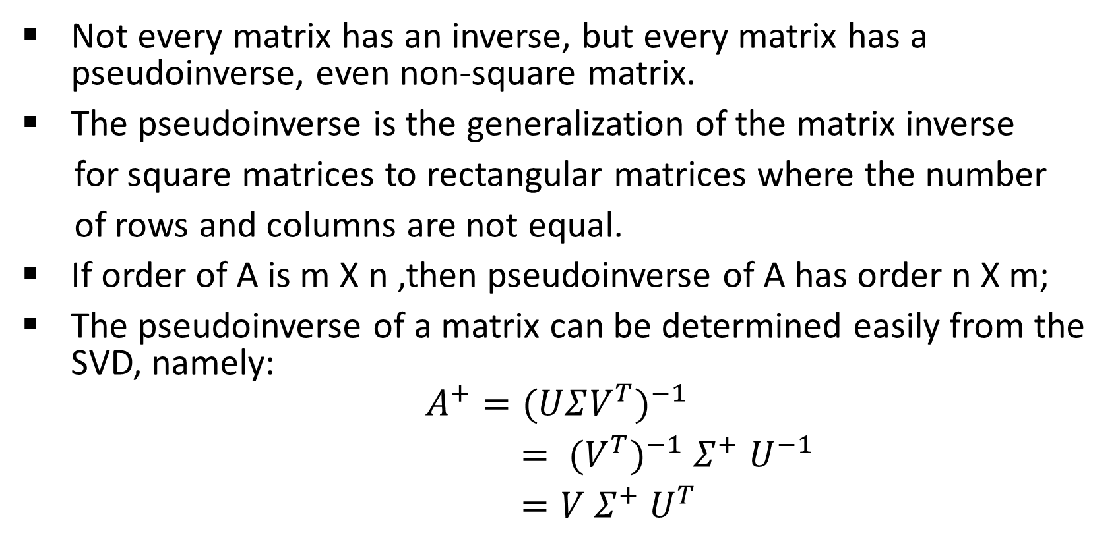
PSEUDO-INVERSE
Not every matrix has an inverse, but every matrix has a pseudoinverse, even non-square matrix.
The pseudoinverse is the generalization of the matrix inverse
for square matrices to rectangular matrices where the number
of rows and columns are not equal.
If order of A is m X n ,then pseudoinverse of A has order n X m;
The pseudoinverse of a matrix can be determined easily from the SVD, namely:
$$A^{+}={(UΣV^{T})}^{−1}$$
$= {(V^{T})}^{−1}$ $Σ^{+}$ $U^{−1}$
$=V Σ^{+}$ $U^{T}$

Slide 2

Where, $Σ$=$\left[\begin{matrix}Σ_{11} & ⋯ & 0 \\ ⋮ & ⋱ & ⋮ \\ 0 & ⋯ & Σ_{nn} \end{matrix}\begin{matrix}0 & ⋯ & 0 \\ ⋮ & ⋱ & ⋮ \\ 0 & … & 0\end{matrix}\right]$ of order m X n
$Σ^{+}=\left[\begin{matrix}1/Σ_{11} & … & 0 \\ ⋮ & ⋱ & ⋮ \\ 0 & … & 1/Σ_{11} \\ 0 & … & 0 \\ ⋮ & ⋱ & ⋮ \\ 0 & … & 0\end{matrix}\right]$ of order n X m
$A_{mXn}$ = $U_{mXm}$ $Σ_{mXn}$ $V_{nXn}^{T}$
$A_{nXm}^{+}$= $V_{nXn}Σ_{nXm}^{+}U_{mXm}^{T}$

Slide 3
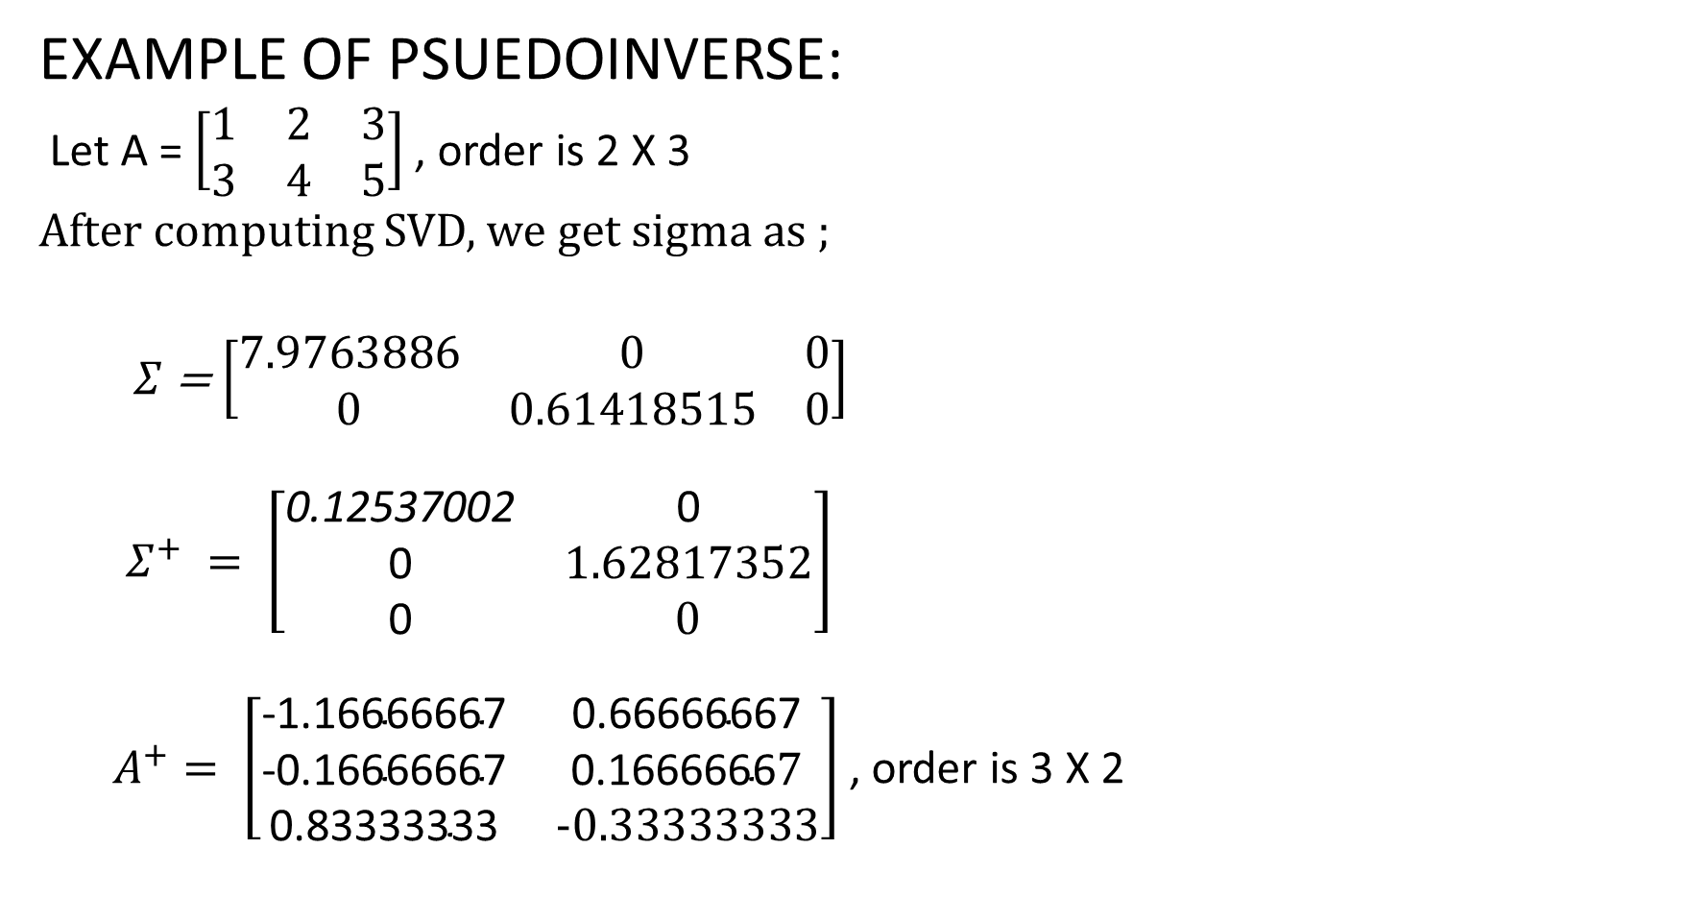
EXAMPLE OF PSUEDOINVERSE:
Let A = $\left[\begin{matrix}1 & 2 & 3 \\ 3 & 4 & 5\end{matrix}\right]$ , order is 2 X 3
After computing SVD, we get sigma as ;
$Σ$ = $\left[\begin{matrix}7.9763886 & 0 & 0 \\ 0 & 0.61418515 & 0\end{matrix}\right]$
$Σ^{+} = \left[\begin{matrix}\text{0.12537002} & \text{0} \\ \text{0} & 1.62817352 \\ \text{0} & 0\end{matrix}\right]$
$A^{+}= \left[\begin{matrix}\text{-1.16666667} & \text{0.66666667} \\ \text{-0.16666667} & \text{0.1666666}7 \\ \text{0.83333333} & -0.33333333\end{matrix}\right]$, order is 3 X 2

Slide 4
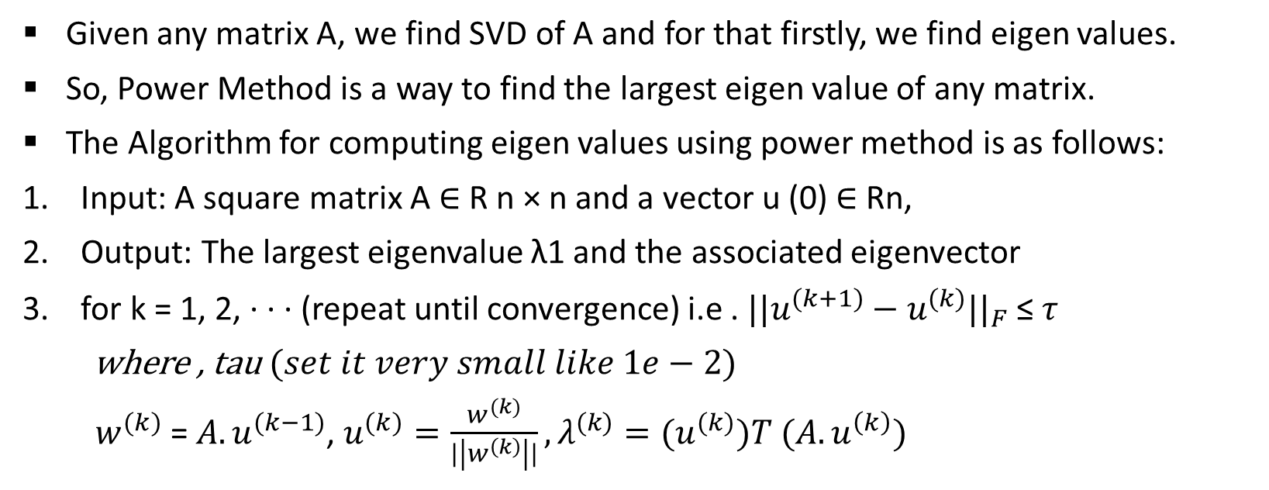
POWER METHOD for computing SVD
Given any matrix A, we find SVD of A and for that firstly, we find eigen values.
So, Power Method is a way to find the largest eigen value of any matrix.
The Algorithm for computing eigen values using power method is as follows:
Input: A square matrix A ∈ R n × n and a vector u (0) ∈ Rn,
Output: The largest eigenvalue λ1 and the associated eigenvector
for k = 1, 2, · · · (repeat until convergence) i.e . ${||u^{(k+1)}−u^{(k)}||}_{F}$≤$τ$
where , tau $(set it very small like 1e−2)$
$w^{(k)}$ = $A.u^{(k−1)}$, $u^{(k)}=\frac{w^{(k)}}{|\left|w^{\left(k\right)}\right||}, λ^{(k)}={(u}^{(k)})T (A.u^{\left(k\right)})$

Slide 5
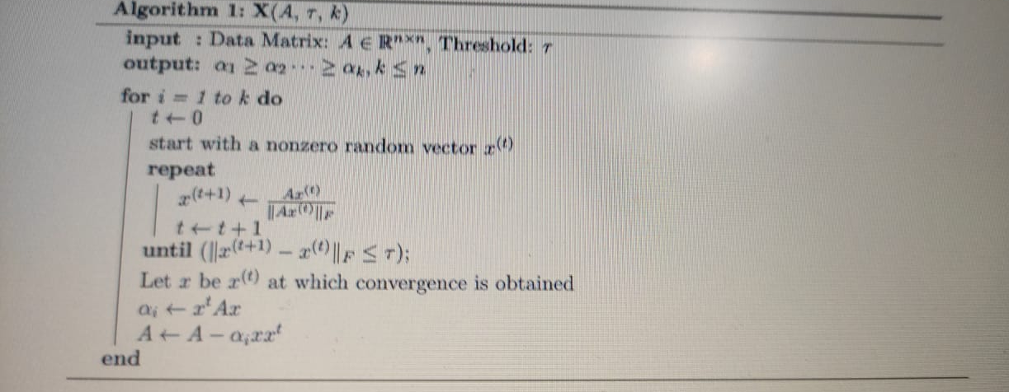
Algorithm of Power Method

Slide 6
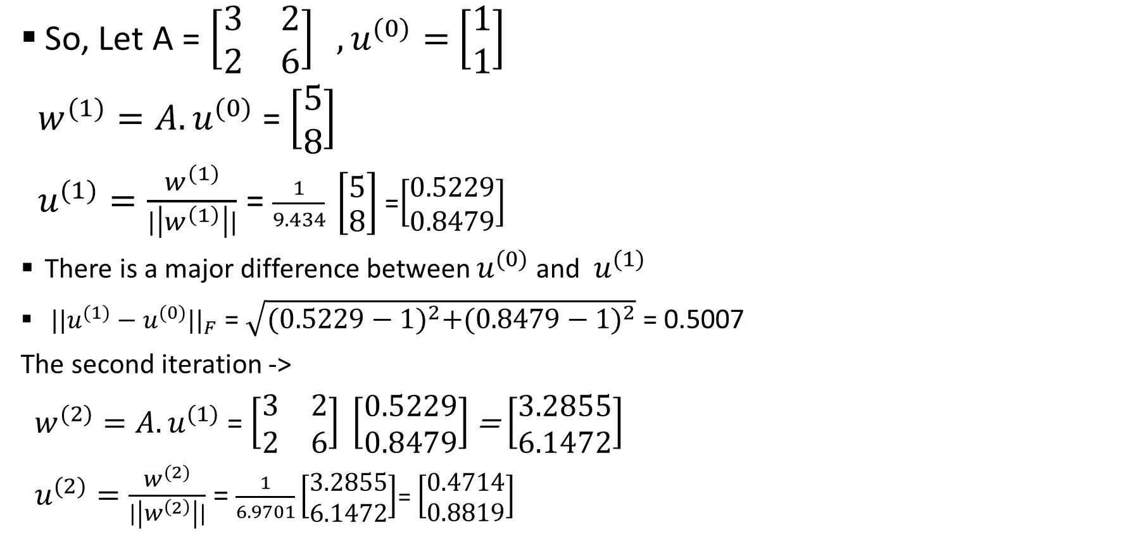
So, Let A = $\left[\begin{matrix}3 & 2 \\ 2 & 6\end{matrix}\right] , u^{(0)}=$ $\left[\begin{aligned}1 \\ 1\end{aligned}\right]$
$w^{(1)}=A.u^{(0)}$ = $\left[\begin{aligned}5 \\ 8\end{aligned}\right]$
$u^{(1)}=\frac{w^{(1)}}{|\left|w^{\left(1\right)}\right||}$ = $\frac{1}{9.434} \left[\begin{aligned}5 \\ 8\end{aligned}\right]$=$\left[\begin{matrix}0.5229 \\ 0.8479\end{matrix}\right]$
There is a major difference between $u^{(0)}$ and $u^{(1)}$
${||u^{(1)}−u^{(0)}||}_{F}$ = $\sqrt{{(0.5229−1)}^{2}+{(0.8479−1)}^{2}}$ = 0.5007
The second iteration ->
$w^{(2)}=A.u^{(1)}$ = $\left[\begin{matrix}3 & 2 \\ 2 & 6\end{matrix}\right] \left[\begin{matrix}0.5229 \\ 0.8479\end{matrix}\right]$ = $\left[\begin{matrix}3.2855 \\ 6.1472\end{matrix}\right]$
$u^{(2)}=\frac{w^{(2)}}{|\left|w^{\left(2\right)}\right||}$ = $\frac{1}{6.9701}\left[\begin{matrix}3.2855 \\ 6.1472\end{matrix}\right]$= $\left[\begin{matrix}0.4714 \\ 0.8819\end{matrix}\right]$

Slide 7
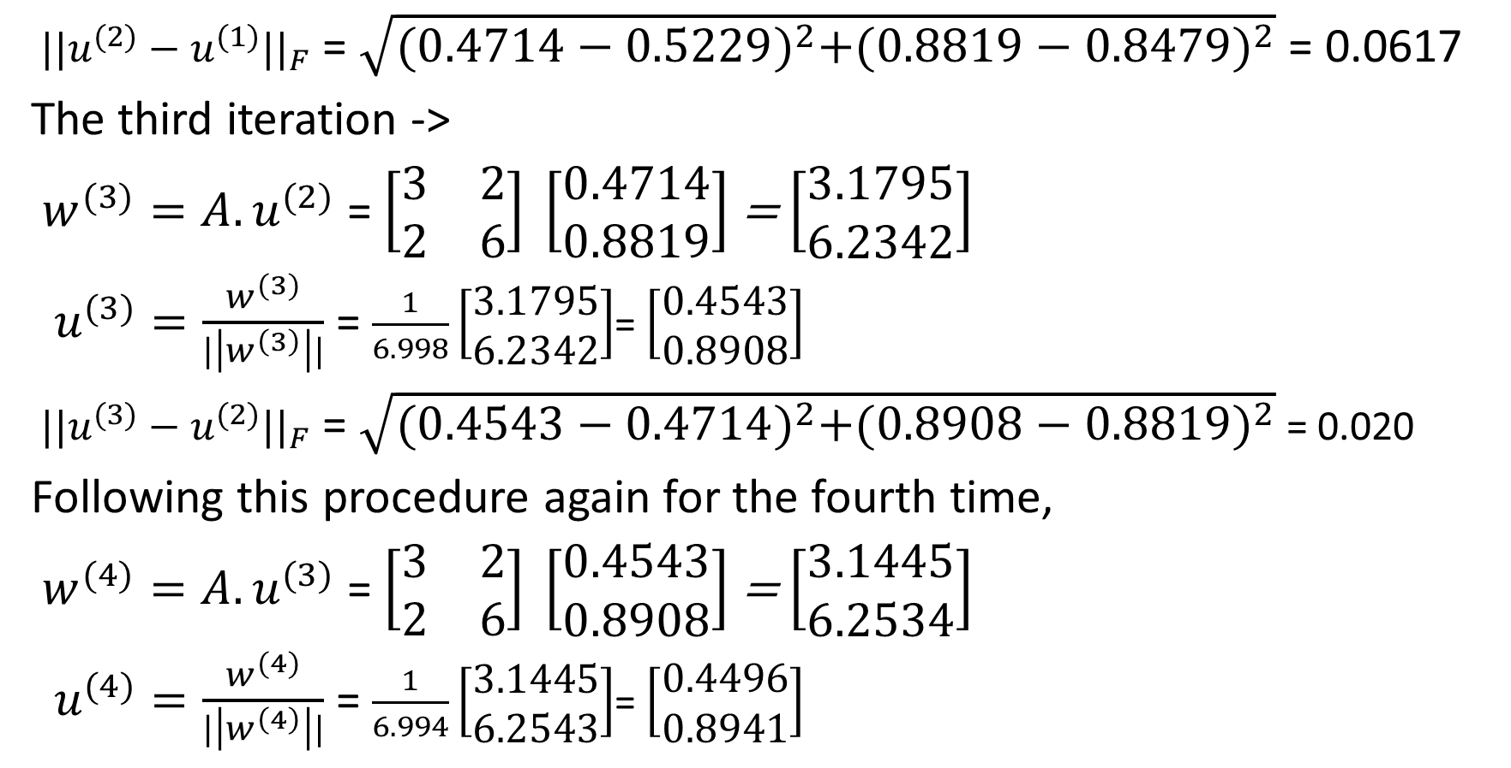
${||u^{(2)}−u^{(1)}||}_{F}$ = $\sqrt{{(0.4714−0.5229)}^{2}+{(0.8819−0.8479)}^{2}}$ = 0.0617
The third iteration ->
$w^{(3)}=A.u^{(2)}$ = $\left[\begin{matrix}3 & 2 \\ 2 & 6\end{matrix}\right] \left[\begin{matrix}0.4714 \\ 0.8819\end{matrix}\right]$ = $\left[\begin{matrix}3.1795 \\ 6.2342\end{matrix}\right]$
$u^{(3)}=\frac{w^{(3)}}{|\left|w^{\left(3\right)}\right||}$ = $\frac{1}{6.998}\left[\begin{matrix}3.1795 \\ 6.2342\end{matrix}\right]$= $\left[\begin{matrix}0.4543 \\ 0.8908\end{matrix}\right]$
${||u^{(3)}−u^{(2)}||}_{F}$ = $\sqrt{{(0.4543−0.4714)}^{2}+{(0.8908−0.8819)}^{2}}$ = 0.020
Following this procedure again for the fourth time,
$w^{(4)}=A.u^{(3)}$ = $\left[\begin{matrix}3 & 2 \\ 2 & 6\end{matrix}\right] \left[\begin{matrix}0.4543 \\ 0.8908\end{matrix}\right]$ = $\left[\begin{matrix}3.1445 \\ 6.2534\end{matrix}\right]$
$u^{(4)}=\frac{w^{(4)}}{|\left|w^{\left(4\right)}\right||}$ = $\frac{1}{6.994}\left[\begin{matrix}3.1445 \\ 6.2543\end{matrix}\right]$= $\left[\begin{matrix}0.4496 \\ 0.8941\end{matrix}\right]$

Slide 8
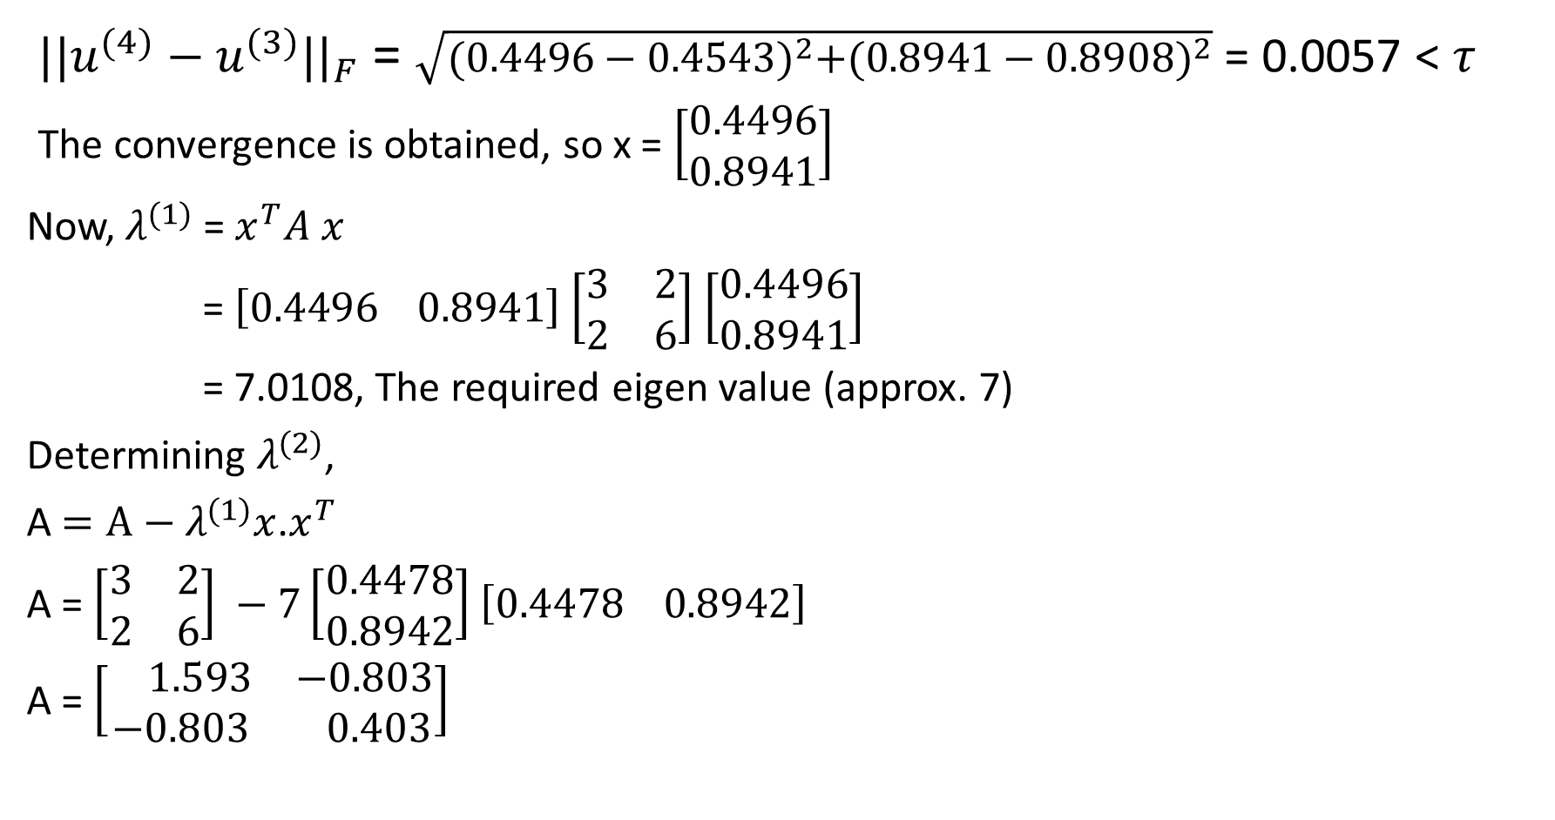
${||u^{(4)}−u^{(3)}||}_{F}$ = $\sqrt{{(0.4496−0.4543)}^{2}+{(0.8941−0.8908)}^{2}}$ = 0.0057 < $τ$
The convergence is obtained, so x = $\left[\begin{matrix}0.4496 \\ 0.8941\end{matrix}\right]$
Now, $λ^{(1)}$ = $x^{T}A x$
= $\left[0.4496 0.8941\right]$ $\left[\begin{matrix}3 & 2 \\ 2 & 6\end{matrix}\right]$ $\left[\begin{matrix}0.4496 \\ 0.8941\end{matrix}\right]$
= 7.0108, The required eigen value (approx. 7)
Determining $λ^{(2)}$,
A $=A−λ^{(1)}x$.$x^{T}$
A = $\left[\begin{matrix}3 & 2 \\ 2 & 6\end{matrix}\right] −7\left[\begin{aligned}0.4478 \\ 0.8942\end{aligned}\right]$ $\left[0.4478 0.8942\right]$
A = $\left[\begin{matrix} 1.593 & −0.803 \\ −0.803 & 0.403\end{matrix}\right]$

Slide 9
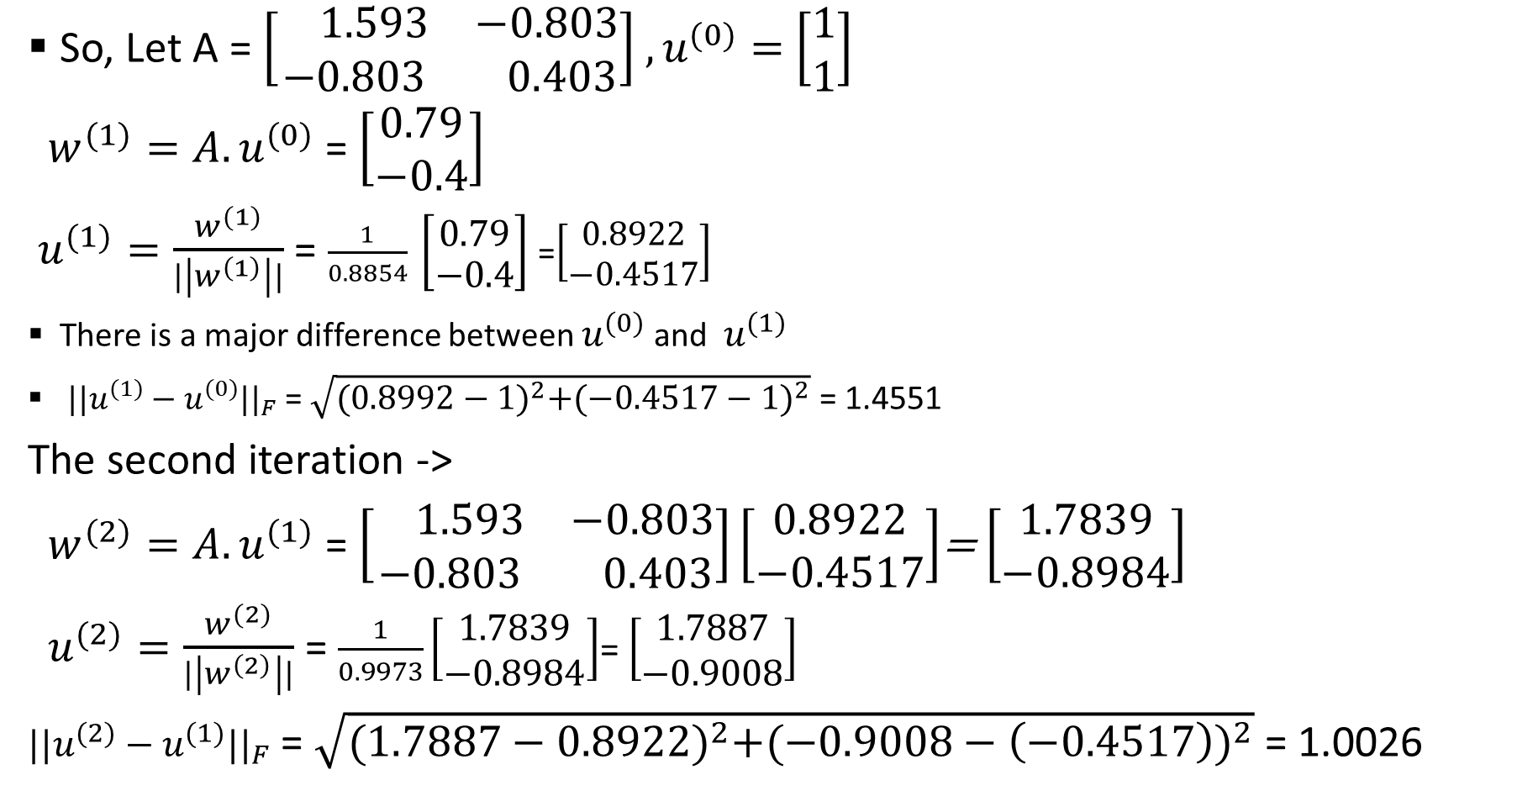
So, Let A = $\left[\begin{matrix} 1.593 & −0.803 \\ −0.803 & 0.403\end{matrix}\right]$ $, u^{(0)}=$ $\left[\begin{aligned}1 \\ 1\end{aligned}\right]$
$w^{(1)}=A.u^{(0)}$ = $\left[\begin{aligned}0.79 \\ −0.4\end{aligned}\right]$
$u^{(1)}=\frac{w^{(1)}}{|\left|w^{\left(1\right)}\right||}$ = $\frac{1}{0.8854} \left[\begin{aligned}0.79 \\ −0.4\end{aligned}\right]$=$\left[\begin{matrix}0.8922 \\ −0.4517\end{matrix}\right]$
There is a major difference between $u^{(0)}$ and $u^{(1)}$
${||u^{(1)}−u^{(0)}||}_{F}$ = $\sqrt{{(0.8992−1)}^{2}+{(−0.4517−1)}^{2}}$ = 1.4551
The second iteration ->
$w^{(2)}=A.u^{(1)}$ = $\left[\begin{matrix} 1.593 & −0.803 \\ −0.803 & 0.403\end{matrix}\right]\left[\begin{matrix}0.8922 \\ −0.4517\end{matrix}\right]$= $\left[\begin{matrix}1.7839 \\ −0.8984\end{matrix}\right]$
$u^{(2)}=\frac{w^{(2)}}{|\left|w^{\left(2\right)}\right||}$ = $\frac{1}{0.9973}\left[\begin{matrix}1.7839 \\ −0.8984\end{matrix}\right]$= $\left[\begin{matrix}1.7887 \\ −0.9008\end{matrix}\right]$
${||u^{(2)}−u^{(1)}||}_{F}$ = $\sqrt{{(1.7887−0.8922)}^{2}+{(−0.9008−\left(−0.4517\right))}^{2}}$ = 1.0026

Slide 10
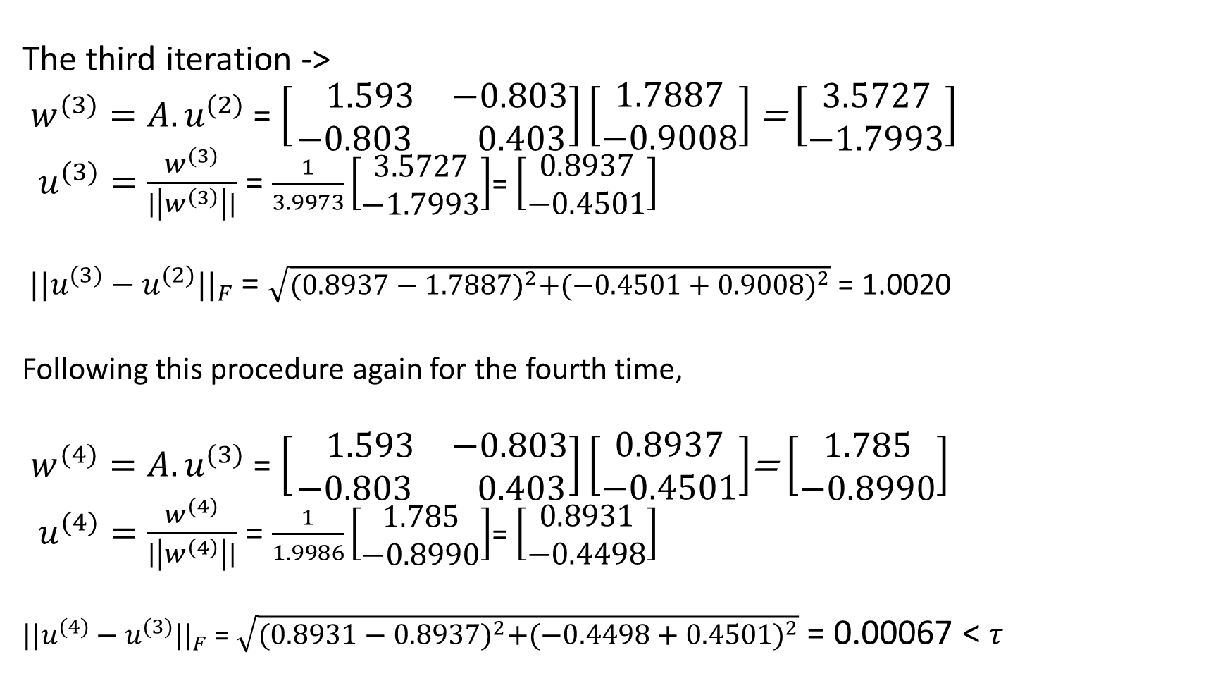
The third iteration ->
$w^{(3)}=A.u^{(2)}$ = $\left[\begin{matrix} 1.593 & −0.803 \\ −0.803 & 0.403\end{matrix}\right]\left[\begin{matrix}1.7887 \\ −0.9008\end{matrix}\right]$ = $\left[\begin{matrix}3.5727 \\ −1.7993\end{matrix}\right]$
$u^{(3)}=\frac{w^{(3)}}{|\left|w^{\left(3\right)}\right||}$ = $\frac{1}{3.9973}\left[\begin{matrix}3.5727 \\ −1.7993\end{matrix}\right]$= $\left[\begin{matrix}0.8937 \\ −0.4501\end{matrix}\right]$
${||u^{(3)}−u^{(2)}||}_{F}$ = $\sqrt{{(0.8937−1.7887)}^{2}+{(−0.4501+0.9008)}^{2}}$ = 1.0020
Following this procedure again for the fourth time,
$w^{(4)}=A.u^{(3)}$ = $\left[\begin{matrix} 1.593 & −0.803 \\ −0.803 & 0.403\end{matrix}\right]\left[\begin{matrix}0.8937 \\ −0.4501\end{matrix}\right]$= $\left[\begin{matrix}1.785 \\ −0.8990\end{matrix}\right]$
$u^{(4)}=\frac{w^{(4)}}{|\left|w^{\left(4\right)}\right||}$ = $\frac{1}{1.9986}\left[\begin{matrix}1.785 \\ −0.8990\end{matrix}\right]$= $\left[\begin{matrix}0.8931 \\ −0.4498\end{matrix}\right]$
${||u^{(4)}−u^{(3)}||}_{F}$ = $\sqrt{{(0.8931−0.8937)}^{2}+{(−0.4498+0.4501)}^{2}}$ = 0.00067 < $τ$

Slide 11
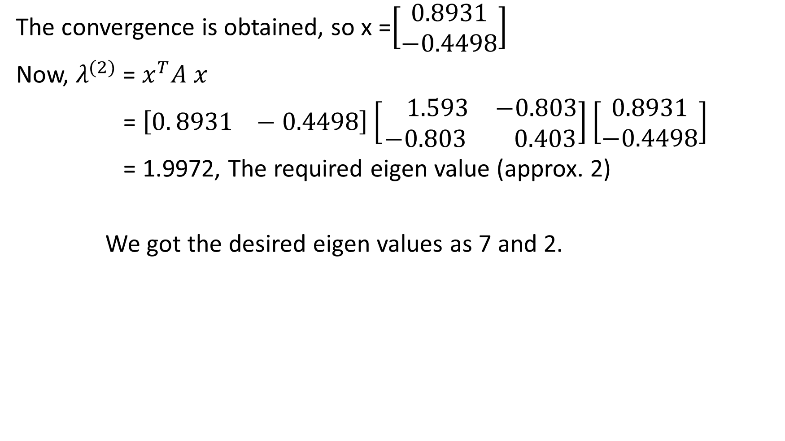
The convergence is obtained, so x =$\left[\begin{matrix}0.8931 \\ −0.4498\end{matrix}\right]$
Now, $λ^{(2)}$ = $x^{T}A x$
= $\left[0. 8931 −0.4498\right]\left[\begin{matrix} 1.593 & −0.803 \\ −0.803 & 0.403\end{matrix}\right]\left[\begin{matrix}0.8931 \\ −0.4498\end{matrix}\right]$
= 1.9972, The required eigen value (approx. 2)
We got the desired eigen values as 7 and 2.

Slide 12
THANK YOU

